Slide 1
Chapter 8
Get off to a fast start with jQuery

Slide 2
Objectives (part 1)
Applied
Use jQuery to develop common DOM scripting applications like the Email List, FAQs, Image Swap, and Image Rollover applications that are presented in this chapter.
Knowledge
Describe jQuery.
Describe two ways to include the jQuery library in your web pages.
In general terms, describe the use of jQuery selectors, methods, and event methods.
Describe the syntax for a jQuery selector.
Describe the use of these jQuery methods for working with forms and controls: val(), text(), next(), submit(), and focus().
Describe the use of object chaining.

Slide 3
Objectives (part 2)
Describe the use of these jQuery methods: next(), prev(), find(), attr(), css(), addClass(), removeClass(), toggleClass(), html(), hide(), show(), and each().
Describe the use of these jQuery event methods: ready(), click(), dblclick(), mouseover(), mouseout(), and hover().
Describe the use of the Event object, its currentTarget property, and its preventDefault() method.

Slide 4
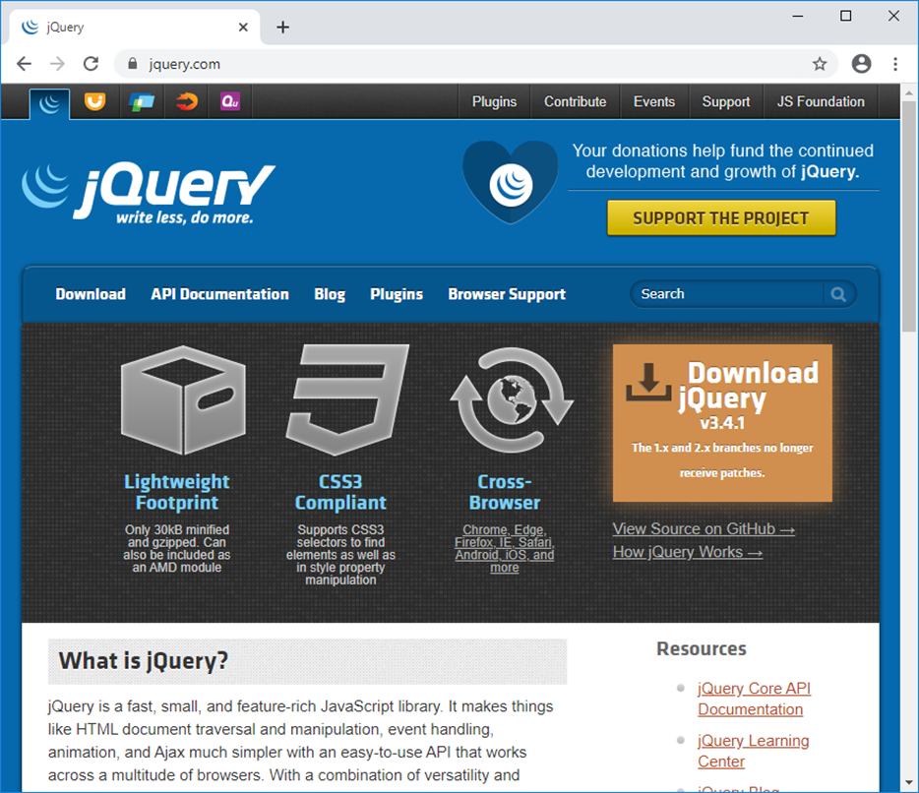
The jQuery website at jquery.com

Slide 5
What jQuery offers
Dozens of selectors, methods, and event methods that make it easier to add JavaScript features to your web pages
A lightweight, compressed library that loads quickly so it doesn’t degrade performance
Cross-browser compatibility
Selectors that are compliant with CSS3

Slide 6
The JavaScript for a FAQs application
"use strict";
document.addEventListener("DOMContentLoaded", () => {
// get the h2 tags
const h2s = document.querySelectorAll("#faqs h2");
// loop through each h2 tag
for (let h2 of h2s) {
// attach an event handler for the h2 tag
h2.addEventListener("click", evt => {
h2.classList.toggle("minus");
h2.nextElementSibling.classList.toggle("open");
evt.preventDefault();
});
}
// set focus on first h2 tag's <a> tag
h2s[0].firstChild.focus();
});

Slide 7
The equivalent JavaScript and jQuery
"use strict";
$(document).ready( () => {
// attach event handler for all h2 tags
$("#faqs h2").click( evt => {
// get clicked h2 tag
const h2 = evt.currentTarget;
// toggle minus class for h2 tag
// and show or hide related div
$(h2).toggleClass("minus");
$(h2).next().toggleClass("open");
evt.preventDefault();
});
// set focus on first h2 tag's <a> tag
$("#faqs").find("a:first").focus();
});

Slide 8
The download page for jQuery
https://jquery.com/download/
How to include jQuery 3.4.1 after you’ve downloaded it to your computer
<script src="jquery-3.4.1.min.js"></script>
How to include jQuery 3.4.1 from a CDN
<script
src="https://code.jquery.com/jquery-3.4.1.min.js">
</script>
How to include the slim version of jQuery 3.4.1 from a CDN
<script
src="https://code.jquery.com/jquery-3.4.1.slim.min.js">
</script>

Slide 9
The most important releases of jQuery
Version Release date Description
1.0 Aug 2006 First stable release.
1.9.1 Feb 2013 Deprecated interfaces removed.
1.12.4 May 2016 Last updated version of 1.x branch, which supports IE6-8.
2.0 April 2013 First version of 2.x branch. Dropped support for IE6-8.
2.2.4 May 2016 Last updated version of 2.x branch.
3.0 June 2016 First version of 3.x branch. A smaller, faster version of the 2.x branch, but with some breaking changes. Adds a slim version.
3.4.1 May 2019 Current version of jQuery.

Slide 10
Two jQuery migrate plugins
Version Description
1.4.1 Restores features dropped by version 1.9.
3.0.0 Restores features dropped by version 3.0.

Slide 11
How to include SRI checking with the jQuery CDN
<script src="https://code.jquery.com/jquery-3.4.1.min.js" integrity="sha256-hVVnYaiADRTO2PzUGmuLJr8BLUSjGIZsDYGmIJLv2b8=" crossorigin="anonymous"></script>

Slide 12
The syntax for a jQuery selector
$("selector")

Slide 13
The HTML for the selected elements
<main id="faqs">
<h1>jQuery FAQs</h1>
<h2 class="minus"><a href="#">What is jQuery?</a></h2>
<div>
<p>jQuery is a library of the JavaScript functions that
you're most likely to need as you develop websites.
</p>
</div>
<h2><a href="#">Why is jQuery so popular?</a></h2>
<div>
<p>Three reasons:</p>
<ul>
<li>It's free.</li>
<li>It lets you get more done in less time.</li>
<li>All of its functions are cross-browser
compatible.</li>
</ul>
</div>
</main>

Slide 14
How to select elements by element, id, and class
By element type: All <p> elements in the entire document
$("p")
By id: The element with “faqs” as its id
$("#faqs")
By class: All elements with “minus” as a class
$(".minus")

Slide 15
How to select elements by relationship
Descendants: All <p> elements that are descendants of the main element
$("#faqs p")
Adjacent siblings: All div elements that are adjacent siblings of h2 elements
$("h2 + div")
General siblings: All <p> elements that are siblings of ul elements
$("ul ~ p")
Children: All ul elements that are children of div elements
$("div > ul")

Slide 16
How to code multiple selectors
$("#faqs li, div p")
$("p + ul, div ~ p")

Slide 17
The syntax for calling a jQuery method
$("selector").methodName(parameters)
Some common jQuery methods
val()
val(value)
text()
text(value)
next([type])
submit()
focus()

Slide 18
Examples that call jQuery methods
How to get the value from a text box
const gallons = $("#gallons").val();
How to set the value for an input element
$("#gallons").val("");
How to set the text in an element
$("#email_error").text("Email address is required");
How to set the text for the next sibling with object chaining
$("#last_name").next().text("Last name is required");
How to submit a form
$("#join_list").submit();
How to move the focus to a form control or link
$("#email").focus();

Slide 19
The syntax for a jQuery event method
$(selector).eventMethodName( () => {
// the statements of the event handler
});
Two common jQuery event methods
Event method Description
ready(handler) The event handler runs when the DOM is ready.
click(handler) The event handler runs when the selected element is clicked.

Slide 20
Two ways to code the ready() event method
The long way
$(document).ready( () => {
alert("The DOM is ready");
});
The short way
$(() => { // (document).ready is assumed
alert("The DOM is ready");
});

Slide 21
How to attach an event handler to the click event of all h2 elements
$("h2").click( () => {
alert("This heading has been clicked");
});
The click() event method within the ready() event method
$(document).ready( () => {
$("h2").click( () => {
alert("This heading has been clicked");
}); // end click()
}); // end ready()

Slide 22
Terms
Content Delivery Network (CDN)
selector
method
object chaining
event method

Slide 23
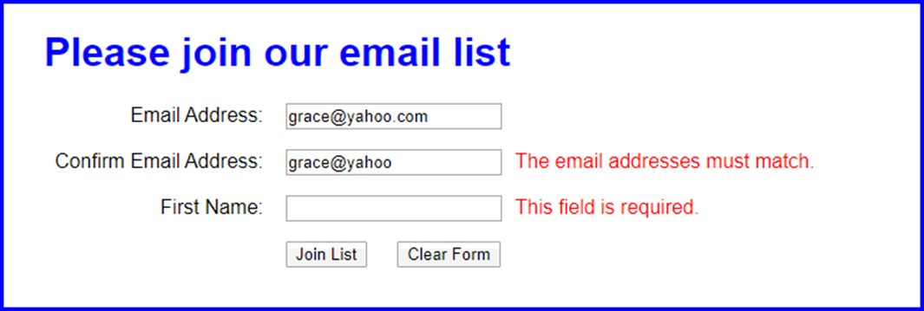
The user interface for the Email List application

Slide 24
The HTML for the Email List application (part 1)
<!DOCTYPE html>
<html>
<head>
<meta charset="UTF-8">
<meta name="viewport"
content="width=device-width, initial-scale=1">
<title>Join Email List</title>
<link rel="stylesheet" href="email_list.css">
</head>
<body>
<main>
<h1>Please join our email list</h1>
<form id="email_form" name="email_form"
action="join.html" method="get">
<div>
<label for="email_1">Email Address:</label>
<input type="text" id="email_1" name="email_1">
<span>*</span>
</div>
<div>
<label for="email_2">Confirm Email Address:</label>
<input type="text" id="email_2" name="email_2">
<span>*</span>
</div>

Slide 25
The HTML for the Email List application (part 2)
<div>
<label for="first_name">First Name</label>
<input type="text" id="first_name"
name="first_name">
<span>*</span>
</div>
<div>
<label>&nbsp;</label>
<input type="button" id="join_list"
value="Join List">
<input type="button" id="clear_form"
value="Clear Form">
</div>
</form>
</main>
<script src="https://code.jquery.com/jquery-3.4.1.slim.min.js">
</script>
<script src="email_list.js"></script>
</body>
</html>

Slide 26
The JavaScript and jQuery for the Email List application (part 1)
$(document).ready( () => {
// handle click on Join List button
$("#join_list").click( () => {
const email1 = $("#email_1").val();
const email2 = $("#email_2").val();
let isValid = true;
if (email1 == "") {
$("#email_1").next().text("This field is required.");
isValid = false;
} else {
$("#email_1").next().text("");
}
if (email2 == "") {
$("#email_2").next().text("This field is required.");
isValid = false;
} else if (email1 != email2) {
$("#email_2").next().text(
"The email addresses must match.");
isValid = false;

Slide 27
The JavaScript and jQuery for the Email List application (part 2)
} else {
$("#email_2").next().text("");
}
if ($("#first_name").val() == "") {
$("#first_name").next().text(
"This field is required.");
isValid = false;
}
else {
$("#first_name").next().text("");
}
// submit the form if all entries are valid
if (isValid) {
$("#email_form").submit();
}
});

Slide 28
The JavaScript and jQuery for the Email List application (part 3)
// handle click on Clear Form button
$("#clear_form").click( () => {
$("#email_1").val("");
$("#email_2").val("");
$("#first_name").val("");
$("#email_1").next().text("*");
$("#email_2").next().text("*");
$("#first_name").next().text("*");
$("#email_1").focus();
});
$("#email_1").focus();
});

Slide 29
A summary of the most useful jQuery selectors
[attribute] :hidden
[attribute=value] :last
:contains(text) :last-child
:empty :lt(n)
:eq(n) :not(selector)
:even :nth-child
:first :odd
:first-child :only-child
:gt(n) :parent
:has(selector) :text
:header :visible

Slide 30
Examples that use jQuery selectors
Select the li elements that are the first child of their parent element
$("li:first-child")
Select the even tr elements of a table
$("table > tr:even") // numbering starts at 0,
// so first tag is even
Select the third descendant <p> element of an element
$("#faqs p:eq(2)") // numbering starts at 0
Select all input elements with “text” as the type attribute
$(":text")

Slide 31
Some of the most useful jQuery methods
next([selector])
prev([selector])
find(selector)
attr(attrName)
attr(attrName,value)
css(propName)
css(propName,value)
addClass(className)
removeClass([className])
toggleClass(className)
html(htmlString)
hide([duration])
show([duration])
each(function)

Slide 32
Examples that use jQuery methods (part 1)
Get the value of the src attribute of an image
$("#image").attr("src");
Set the value of the src attribute of an image to the value of a variable
$("#image").attr("src", imageSource);
Set the value of the color property of the h2 elements
$("h2").css("color", "blue");
Add a class to the h2 descendants of the “faqs” element
$("#faqs h2").addClass("minus");

Slide 33
Examples that use jQuery methods (part 2)
Put an h2 element into an aside element
$("aside").html("<h2>Table of Contents</h2>");
Run a function for each <a> element within an “image_list” element
$("#image_list a").each( (index, elem) => {
// the statements of the function
});

Slide 34
Some of the most useful jQuery event methods
ready(handler)
click(handler)
dblclick(handler)
mouseenter(handler)
mouseover(handler)
mouseout(handler)
hover(handlerIn,handlerOut)

Slide 35
A property and a method of the Event object
currentTarget
preventDefault()

Slide 36
A double-click() event method for all text boxes
$(":text").dblclick( evt => {
evt.currentTarget.value = ""; // clear text box
});
A hover() event method for each img element within a list
$("#image_list img").hover(
() => alert("The mouse pointer has moved " +
"into an img element"),
() => alert("The mouse pointer has moved " +
"out of an img element)
);

Slide 37
A preventDefault() method that stops the default action of an event
$("#faqs a").click( evt => { // evt is the Event object
evt.preventDefault();
});

Slide 38
Other event methods that you should be aware of
Event method Description
on(events, handler) Attach an event handler to one or more events.
off(events,[handler]) Remove an event handler from one or more events.
one(event,handler) Attach an event handler and remove it after it runs one time.
trigger(event) Trigger the event for the selected element.

Slide 39
How to attach an event handler to an event
With the on() event method
$("#clear").on("click", () => {...});
With the shortcut method
$("#clear").click( () => {...});

Slide 40
How to attach an event handler to two different events
Of the same element
$("image_list img").on("click mouseover", () => {...});
Of two different elements
const clearClick = () => {...};
$("#clear").click(clearClick);
$(":text").dblclick(clearClick);

Slide 41
How to remove an event handler from an event
$("#clear").off("click");
How to attach and remove an event handler so it runs only once
$("#clear").one("click", () => {...});

Slide 42
How to trigger an event
With the trigger() method
$("#clear").trigger("click");
With the shortcut method
$("#clear").click();
How to trigger an event from an event handler
$(":text").dblclick( () => {
$("#clear").click();
});

Slide 43
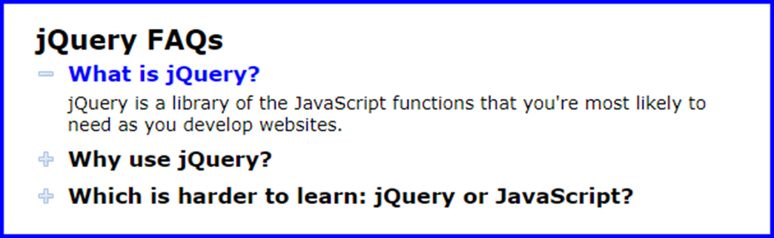
The FAQs application in a browser

Slide 44
Some of the HTML for the FAQs app (part 1)
<main id="faqs">
<h1>JavaScript FAQs</h1>
<h2><a href="#">What is jQuery?</a></h2>
<div>
<p>jQuery is a library of the JavaScript
functions that you're most likely to need as
you develop websites.
</p>
</div>
<h2><a href="#">Why use jQuery?</a></h2>
<div>
<p>Three reasons:</p>
<ul>
<li>It's free.</li>
<li>It lets you get more done in less time.
</li>
<li>It's cross-browser compatible.</li>
</ul>
</div>

Slide 45
Some of the HTML for the FAQs app (part 2)
<h2><a href="#">Which is harder to learn: jQuery or
JavaScript?</a></h2>
<div>
<p>For many things, jQuery is easier to learn
than JavaScript. But remember that jQuery is
JavaScript.
</p>
</div>
</main>
<script
src="https://code.jquery.com/jquery-3.4.1.slim.min.js">
</script>
<script src="faqs.js"></script>

Slide 46
Some of the CSS for the FAQs application
h2 {
background: url(images/plus.png) no-repeat left center;
}
h2.minus {
background: url(images/minus.png) no-repeat left center;
}
div {
display: none;
}

Slide 47
The JavaScript and jQuery for the FAQs application (part 1)
"use strict";
$(document).ready( () => {
// attach event handlers for all h2 tags
$("#faqs h2").click( evt => {
// get clicked h2 tag
const h2 = evt.currentTarget;
// toggle minus class for h2 tag
$(h2).toggleClass("minus");
// show or hide related div
if ($(h2).attr("class") !== "minus") {
$(h2).next().hide();
}

Slide 48
The JavaScript and jQuery for the FAQs application (part 2)
else {
$(h2).next().show();
}
evt.preventDefault();
});
// set focus on first h2 tag's <a> tag
$("#faqs").find("a:first").focus();
});

Slide 49
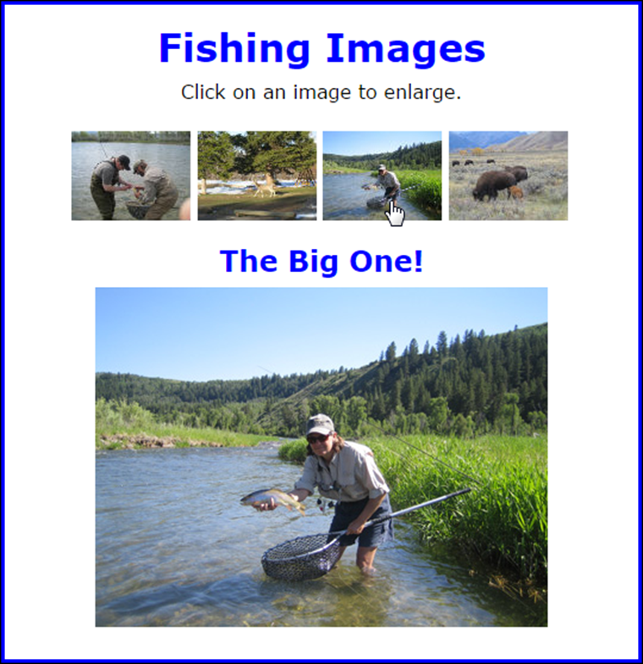
The user interface for the Image Swap application

Slide 50
The HTML for the Image Swap application
<main>
<h1>Fishing Images</h1>
<p>Click on an image to enlarge.</p>
<ul id="image_list">
<li><a href="images/release.jpg"
title="Catch and Release">
<img src="thumbnails/release.jpg" alt=""></a></li>
<li><a href="images/deer.jpg" title="Deer at Play">
<img src="thumbnails/deer.jpg" alt=""></a></li>
<li><a href="images/hero.jpg" title="The Big One!">
<img src="thumbnails/hero.jpg" alt=""></a></li>
<li><a href="images/bison.jpg" title="Grazing Bison">
<img src="thumbnails/bison.jpg" alt=""></a></li>
</ul>
<h2 id="caption">Catch and Release</h2>
<p><img id="main_image" src="images/release.jpg" alt=""></p>
</main>
<script
src="https://code.jquery.com/jquery-3.4.1.slim.min.js">
</script>
<script src="swap.js"></script>

Slide 51
The CSS for the li elements
li {
display: inline;
}

Slide 52
The JavaScript and jQuery for the Image Swap application (part 1)
"use strict";
$(document).ready(() => {
// preload images
$("#image_list a").each( (index, link) => {
const image = new Image();
image.src = link.href;
});
// attach event handlers for links
$("#image_list a").click( evt => {
// get clicked <a> tag
const link = evt.currentTarget;
// swap image
$("#main_image").attr("src", link.href);
//swap caption
$("#caption").text(link.title);

Slide 53
The JavaScript and jQuery for the Image Swap application (part 2)
// cancel the default action of the link
evt.preventDefault();
});
// move focus to first thumbnail
$("li:first-child a").focus();
});

Slide 54
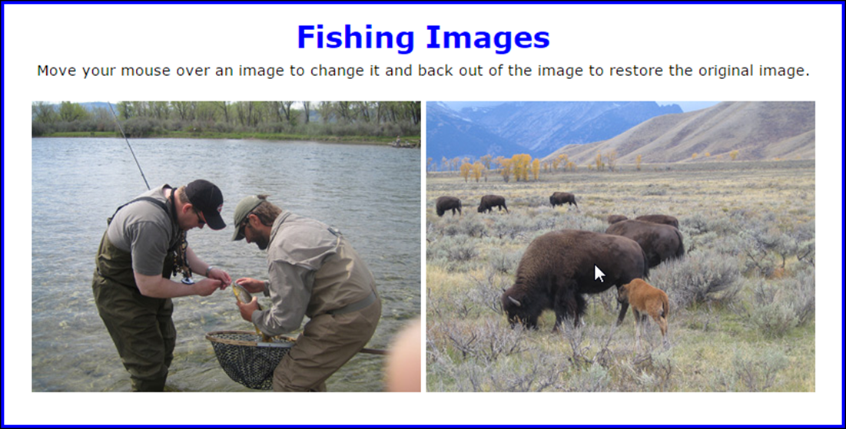
Two images with the second image rolled over

Slide 55
The HTML for the Image Rollover application
<main>
<h1>Fishing Images</h1>
<p>Move your mouse over an image to change it and
back out of the image to restore the original
image.</p>
<ul id="image_rollovers">
<li><img src="images/release.jpg"
alt="" id="images/deer.jpg">
</li>
<li><img src="images/hero.jpg"
alt="" id="images/bison.jpg">
</li>
</ul>
</main>
<script
src="https://code.jquery.com/jquery-3.4.1.slim.min.js">
</script>
<script src="rollover.js"></script>

Slide 56
The JavaScript and jQuery for the Image Rollover application
"use strict";
$(document).ready(() => {
// process each img tag
$("#image_rollovers img").each( (index, img) => {
const oldURL = img.src;
const newURL = img.id;
// preload rollover image
const rolloverImage = new Image();
rolloverImage.src = newURL;
// set up event handlers for hovering over an image
$(img).hover(
() => img.src = newURL, // hover over
() => img.src = oldURL // hover out
);
});
});

